Slide 1


An Industrial Training Presentation
Prepared By: Guided By:
Abhi Bhuva (202003103510192) Dr. Anshuman Kalla
Krishna Kapadia (202003103510205) Professor (CE),
Dhruvil Miyani (202003103510221) CGPIT.
B.Tech. (8th Semester) (CE)
CGPIT.
1

Slide 2
Outline
Company Profile
Timeline Chart (week wise)
Training Work
Technologies/Platform
Screenshot of work during training
References

Slide 3
Company Profile
Company Name: Toshal Infotech
Address: 203, 5thFloor, SNS Interio, beside CNG Station, Bhatar, Surat, Gujarat 395017.
Services: Mobile App Development, Website Development, Vue.js Full Stack Development, Testing and QA, Laravel Development, Software Project Development, Cross App Development, DotNetNuke.
No of employees: 50-100
Starting Year: 2008
Contact: contactus@toshalinfotech.com

Slide 4
Timeline Chart
Cloud
computing ,
use of cloud
computing
Networking basics,
IP Address,
Subnet mask ,
route table
S3 bucket tutorials,
hosting static
site in s3 ,Bucket
versioning
Lambda function
tutorials, Integrating
lambda function with
S3 bucket & Dynamo DB
Week
1
Week
2-3
Week
4-5
Week
6-7
Week
8
Week
9
Week
10
AWS services:
EC2, S3 , RDS,
Route53,
Lambda
EC2 instance
using private IP,
virtual cloud tutorials
RDS backup in S3
bucket using
local machine,
RDS tutorials

Slide 5
Timeline chart
Project title ,AWS
code build and
react app hosting
on EC2 instance
Configuring UI-
testing for react
app using
ghost inspector
Testing code pipeline
and taking backup
of all using AWS
backup service
Configuring code
build and performing
test for react app
Week
11
Week
12
Week
13
Week
14
Week
15
Week
16
Week 17
AWS code commit,
code build, code
deploy and code
pipeline tutorials.
Configuring code
pipeline and
integrating it with
code deploy
Configuring Grafana
and JMeter for performance and
load testing

Slide 6
Week 1
Basics of AWS services and cloud computing:-
Understood the different modules of the AWS platform.
Difference between AZ and regions, explored different types of services in detail.
Gained detailed knowledge about types of deployment models, OSI models – layers of OSI model
Also got to learn about different operating systems.
Explored the network part and vpc part for AWS cloud computing

Slide 7
Week (2-3)
Basics of AWS services and cloud computing.
Different AWS services and its uses.
Created AWS account and setup.
Explored services :- EC2, S3, IAM, Route 53, RDS, etc.
Explored different concepts of AWS platform i.e. where it is used , how to use.
Got details about AWS Billing and Cost Management.
Perform basic tasks related to the AWS services given by the head of the department.

Slide 8
AWS Services
Elastic Compute Cloud (EC2):-
Understanding of EC2 services like launch instances, attached extra volumes, created key-pairs, Elastic IP, etc.
Virtual Private Cloud (VPC):-
Understanding of subnets, Route table, what is internet gateway and gained detailed knowledge about security groups and also made it using different ports such as ssh, http, etc.
Identity and access management(IAM):-
Learning about IAM access, different policies, roles.
Created custom roles and policies and also applied Multi-Factor Authentication (MFA).

Slide 9
Week (4-5)
Simple Storage Service (S3):-
Created a bucket and learned how to upload files .
Hosted a static webpage on s3.
Learned cross bucket replication.
Relational Database Service (RDS):-
RDS configuration and storage.
Different RDS features like parameter group, options group, exports in S3, etc.
Lambda:-
Created a function to trigger the Cloud watch which automatically take snapshots of the EC2 instance.

Slide 10
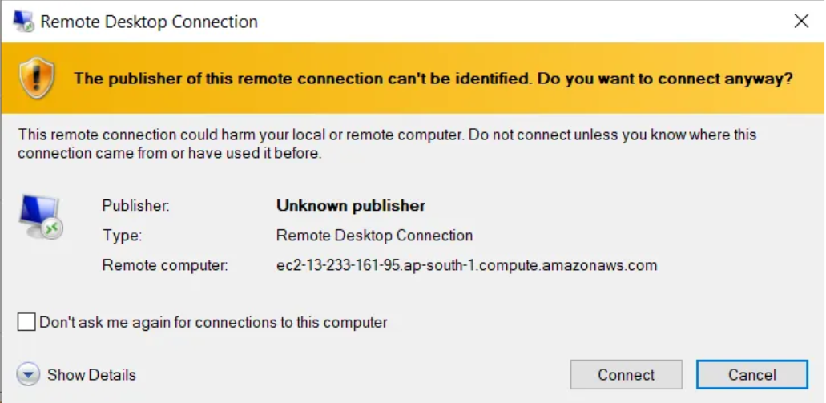
Task of EC-2
Performed tasks for different AWS services:-
EC2- Performed password authentication in windows instance.
After connecting , enter the credentials to get login in to windows instance.
Fig 1.Remote Desktop Connection

Slide 11
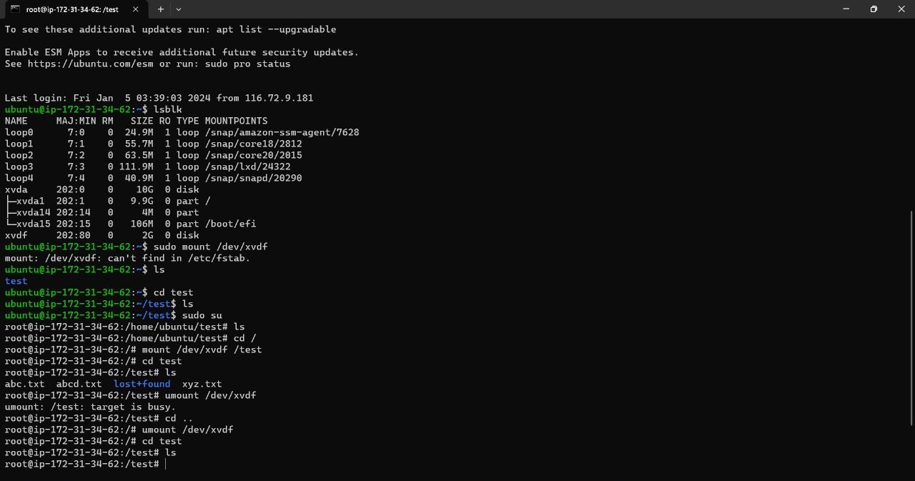
Task of Volume
Attached extra volumes to the instance using EC2 service.
Then using “lsblk” command to check whether volume is attached or not.
Fig 2.EC2 instance

Slide 12
Tasks
Tasks related to IAM service:-
Created two groups (Admin, Developer)
Admin with full rights.
Developer with specific right of using only S3 service.
Tasks related to S3 service:-
S3 can only be accessed by selected EC2 instance.
Tasks related to VPC and EC2:-
Created a route table for a specific virtual private cloud.
Also made personal Amazon Machine Image (AMI) for the EC2 instance.

Slide 13
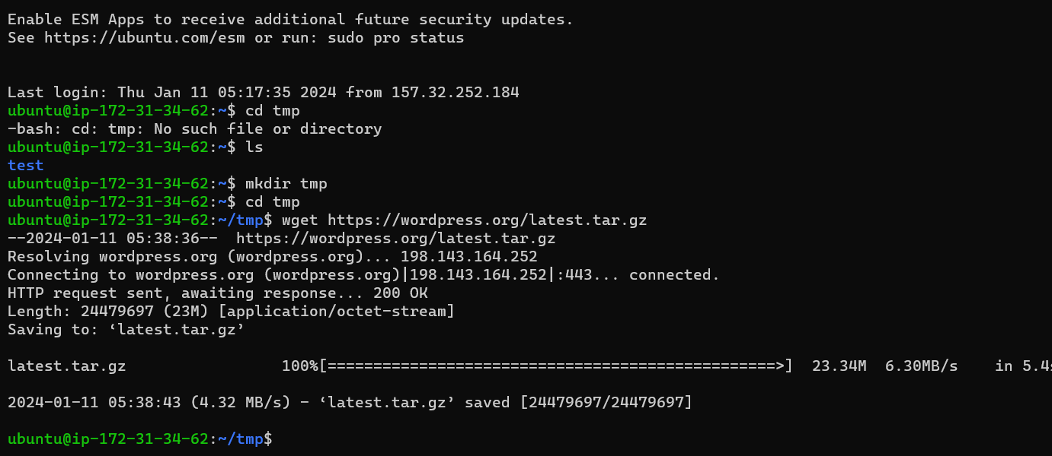
Week (6-7)
2. Task - Hosted a WordPress site on EC2 machine.
Open ubuntu instance and install apache using command sudo apt install apache2.
And also install MySQL in ubuntu instance.
Now create directory tmp and install WordPress using co0mmand wget https://wordpress.org/latest.tar.gz and extract it.
Fig 3.EC-2

Slide 14
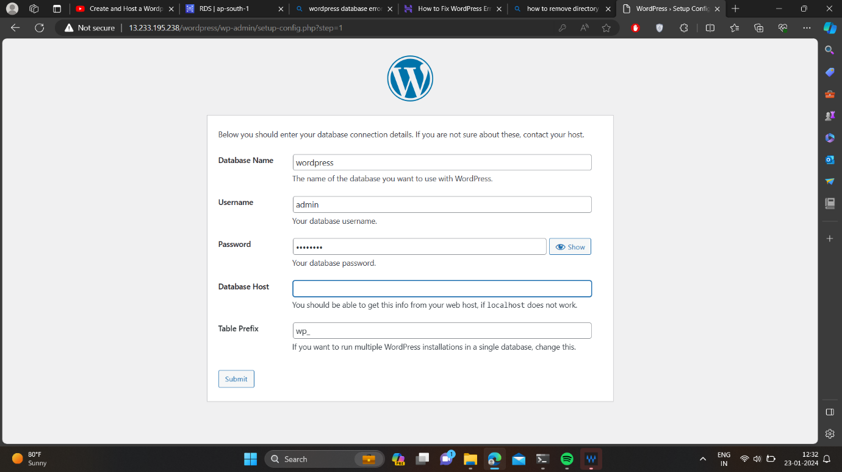
Database credentials
Open tab and write the public ip of instance with wordpress like public-ip/wordpress to set the site.
Firstly set up RDS to link database with the wordpress and then give name of database and user id and password.
Fig 4.Database credentials

Slide 15
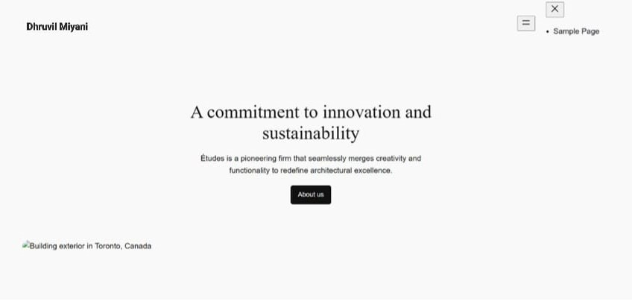
Hosted Site
Fig 5.Wordpress site

Slide 16
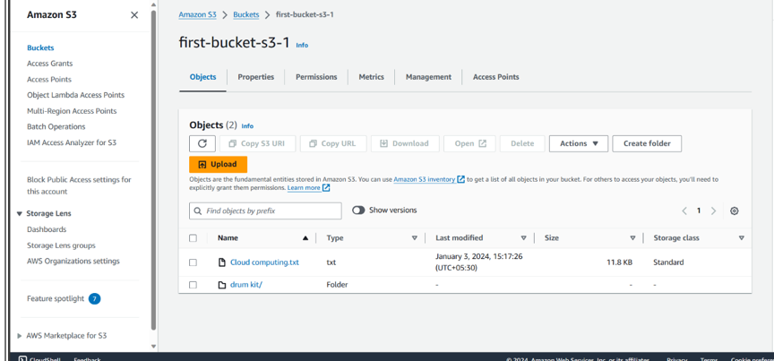
Site hosting on S3
Task – Static site hosting in S3 bucket.
Create S3 bucket and enable public access to it
Now enable static site hosting and upload static site in bucket.
Now open site from s3 bucket.
Fig 6.S3 Bucket

Slide 17
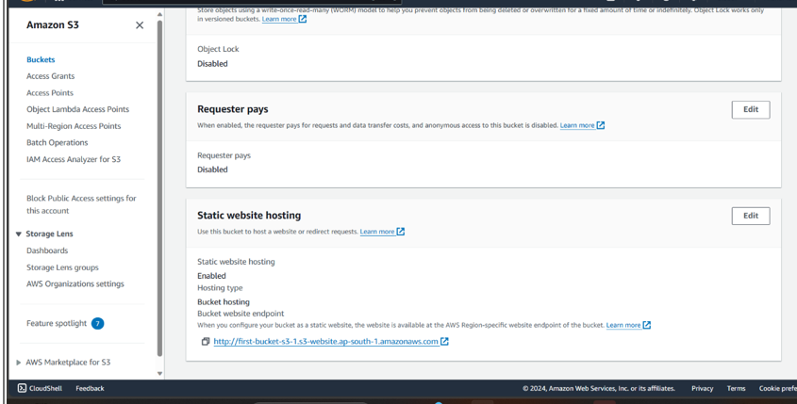
Static site hosting
Fig 7. Static site hosting

Slide 18
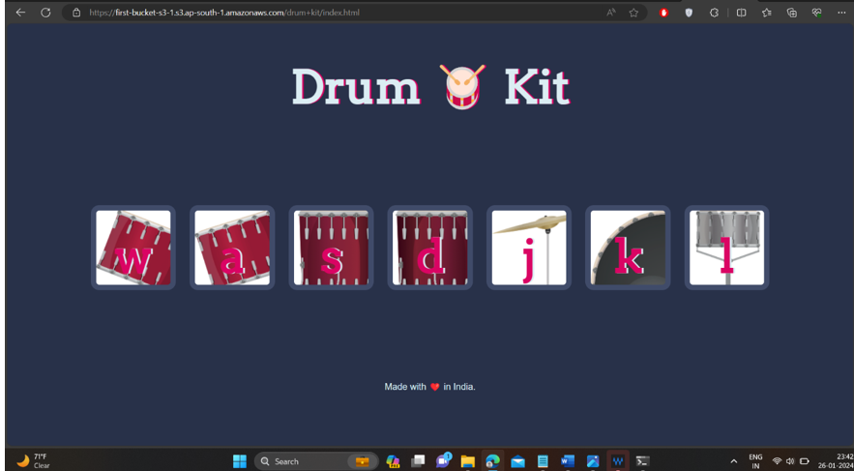
Hosted Website
Fig 8.Drumkit site

Slide 19
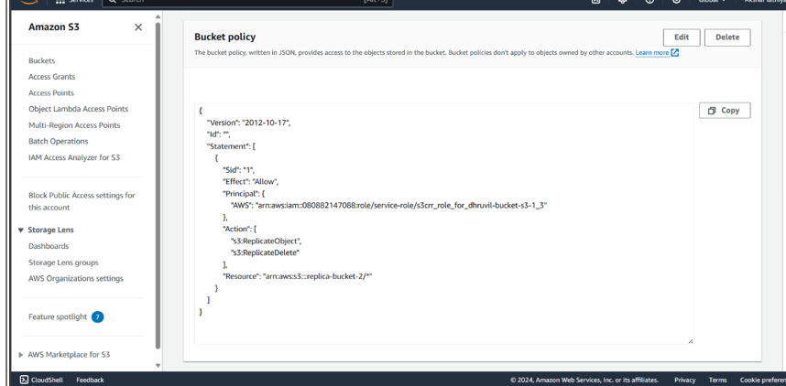
Task of S3
Task – Cross Bucket Replication.
It creates replication of bucket of bucket in different bucket.
It can be created using bucket policy in destination bucket policy.
Fig 9.Bucket policy

Slide 20
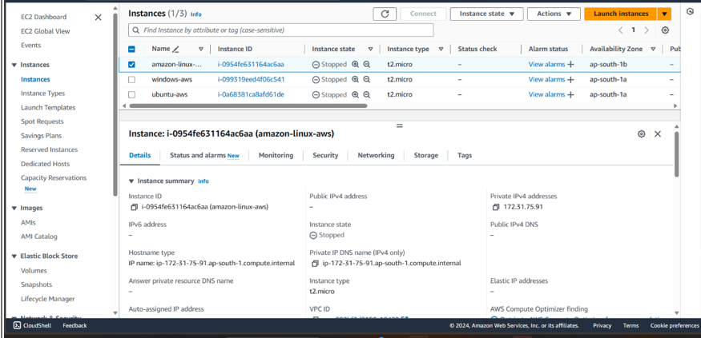
Network Task
Task - Connection of EC2 instance from public and private subnet.
Firstly, create two instance from which only one should be assigned public address and other should be assigned private address.
Create IGW and NAT as it is used to route.
Fig 10.EC-2 Instance

Slide 21
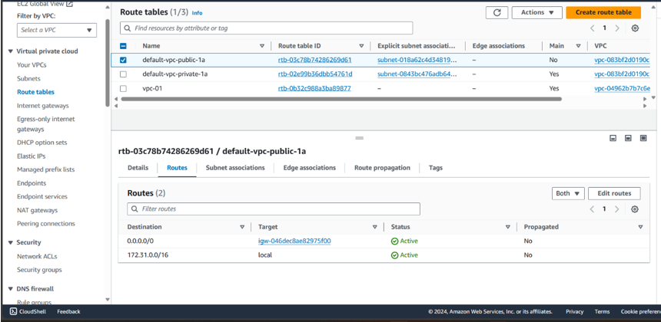
Route Table
Now create two subnets public and private , moreover route the route table of both subnets.
Now the private instance can not be access from local machine, it can be access from machine which is present in public subnet.
Fig 11.Route Table

Slide 22
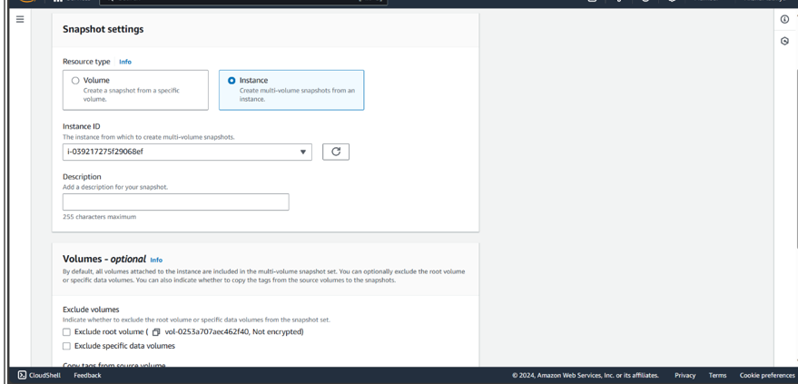
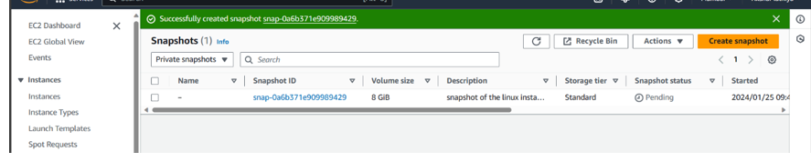
Week (8-9)
Task - EC2 backup snapshot and restore it.
Firstly create snapshot of instance in EC2 service.
Fig 12.Snapshot
Fig 13.Snapshot created

Slide 23
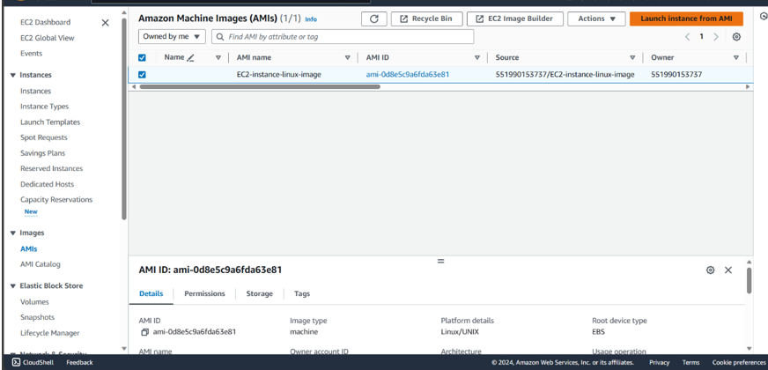
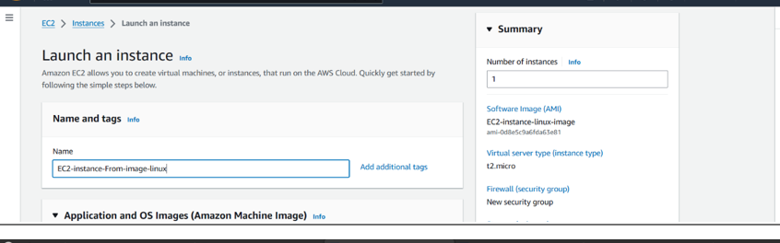
Amazon Machine Image
Now create image of that snapshot.
The image created will be visible in AMI and it restore the instance from it.
Fig 14.AMI
Fig 15.New instance

Slide 24
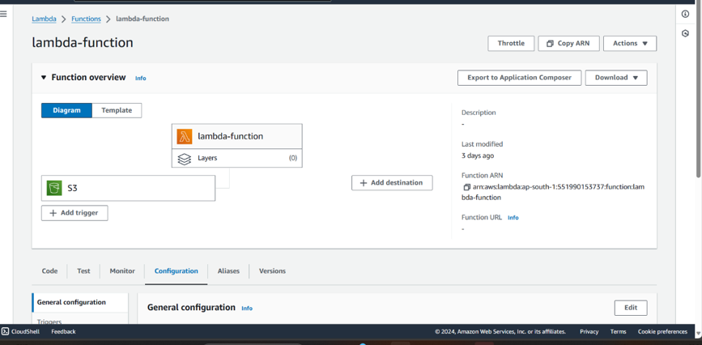
Lambda Function
Task - Lambda function to trigger when file is uploaded in S3 and update file logs in Dynamodb.
Create a function in lambda named lambda-function and add trigger S3 bucket.
Add bucket name in code source inside the lambda function file and test and deploy the file.
Fig 16.Lambda Function

Slide 25
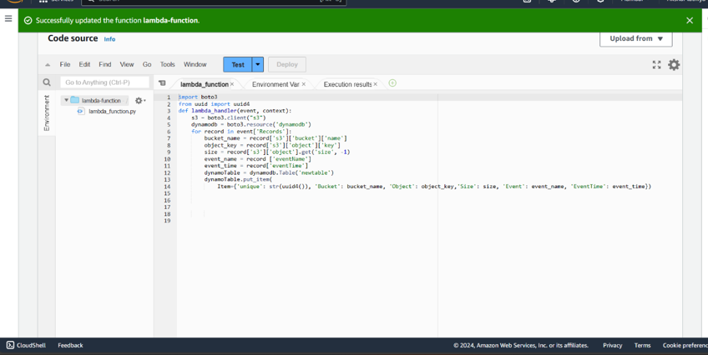
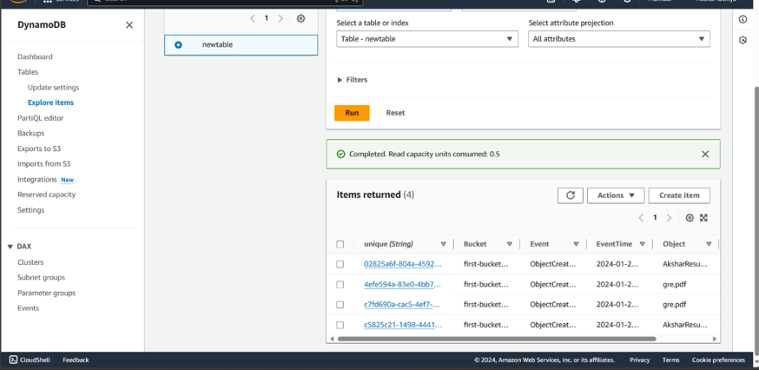
Dynamo db
Upload file in S3 bucket and the lambda function will be trigger and the files will directly updated in dynamodb table.
Fig 17.Code source
Fig 18.Dynamodb

Slide 26
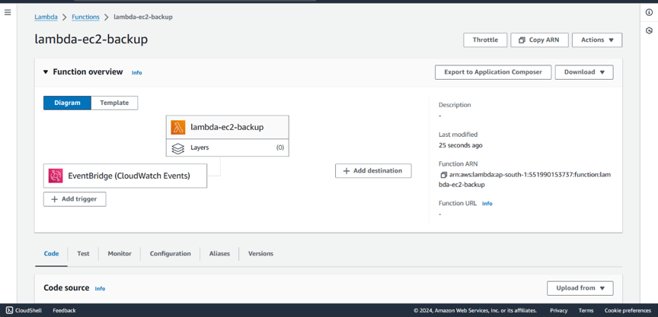
Trigger event
Task - Lambda function to create snapshot on daily basis of EC2 and store in S3 using CloudWatch.
Create a lambda function named lambda-ec2-backup and add trigger CloudWatch Events.
Fig 19.Trigger

Slide 27
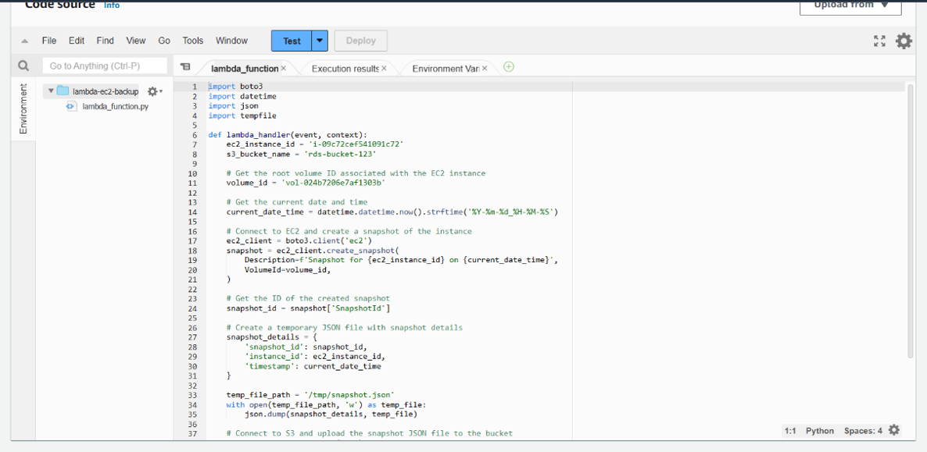
Source code
Add bucket name and instance id of your instance in the json file of lambda code source.
Fig 20.Code source

Slide 28
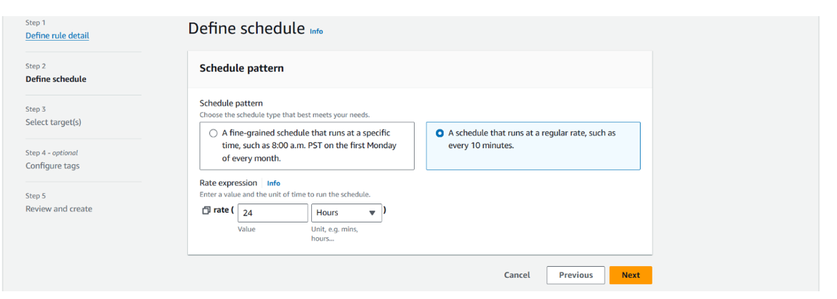
CloudWatch Event
And in CloudWatch Event, define the schedule at which time you want to take snapshots, it will automatically take snapshots as per your schedule.
Fig 21.Define Schedule

Slide 29
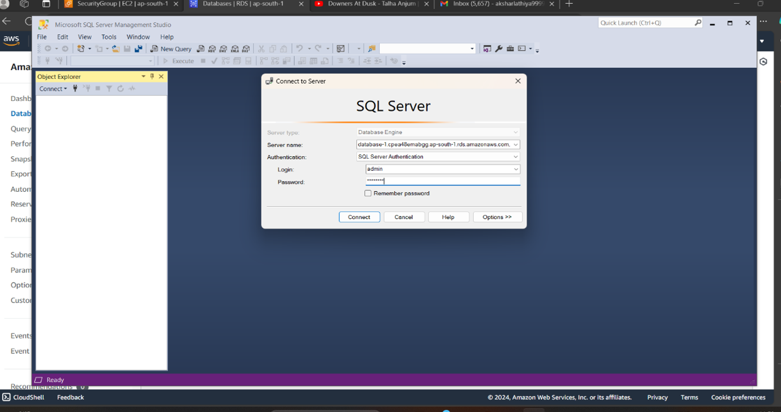
Task of RDS
Task - RDS (Microsoft SQL) backup in S3 using RDS option group.
Firstly, it requires the SSMS to connect RDS from local machine and helps to take backup of database in S3 bucket.
Create a new database in SSMS and add your bucket ARN in which you want the backup files of RDS.
Fig 22.SSMS

Slide 30
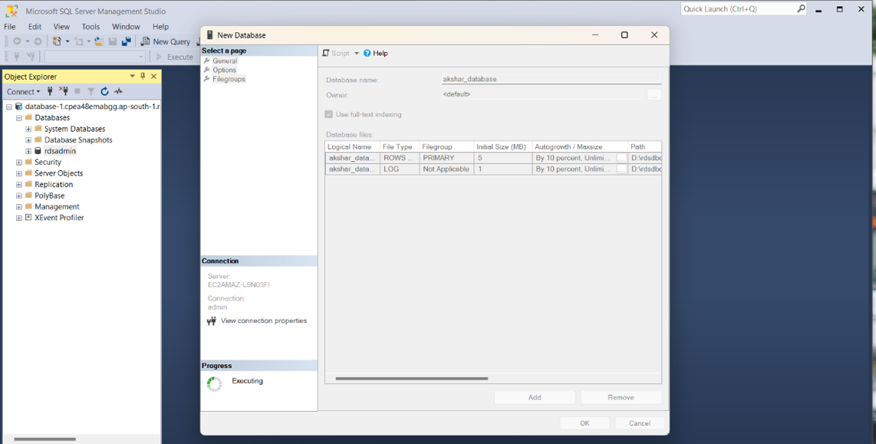
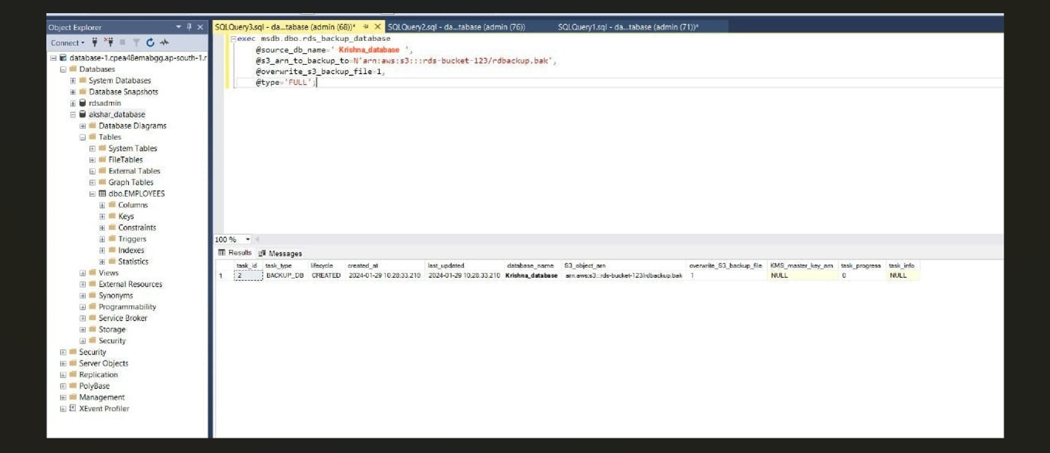
Screenshots of SSMS
Fig 23.Database
Fig 24.Connection of S3

Slide 31
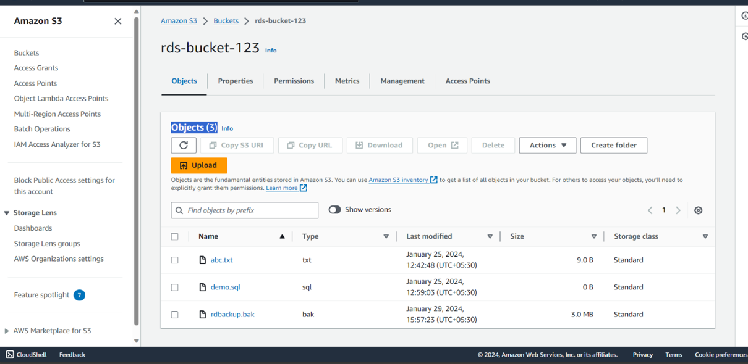
Backup in S3
The backup files will get updated in the S3 bucket named rds-bucket-123.
Fig 25.Backup files

Slide 32
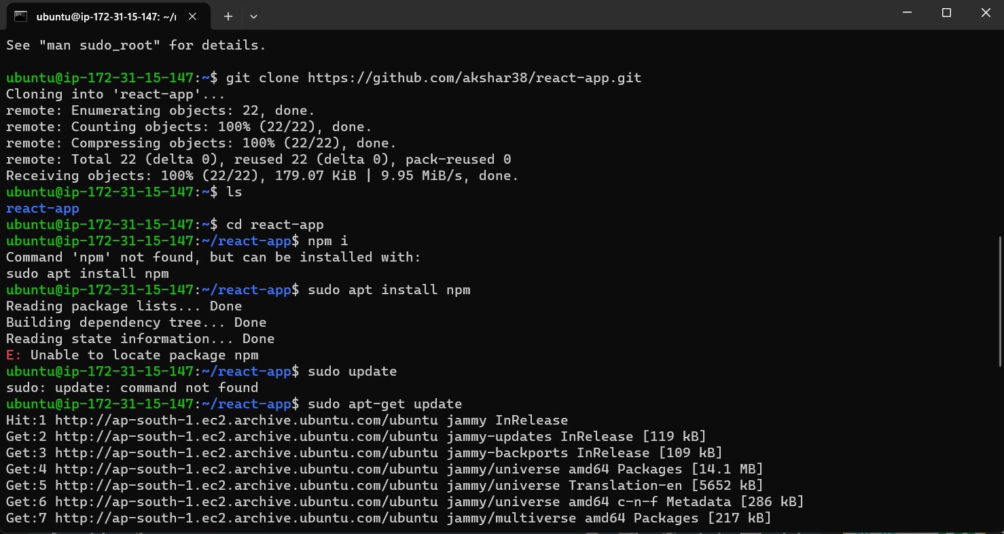
Site hosting on EC-2
Task – Hosting React and Node website on EC-2 machine.
Both website are static and are clonned from github using git clone command.
Install npm in EC2 machine to run the website in machine.
Add port 3000 in the inbound rules of security group to run React site on it and port 80 for Node website.
Fig 26.EC-2 Machine

Slide 33
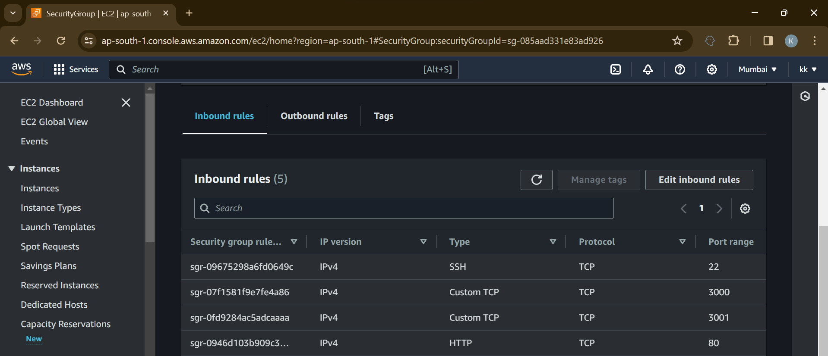
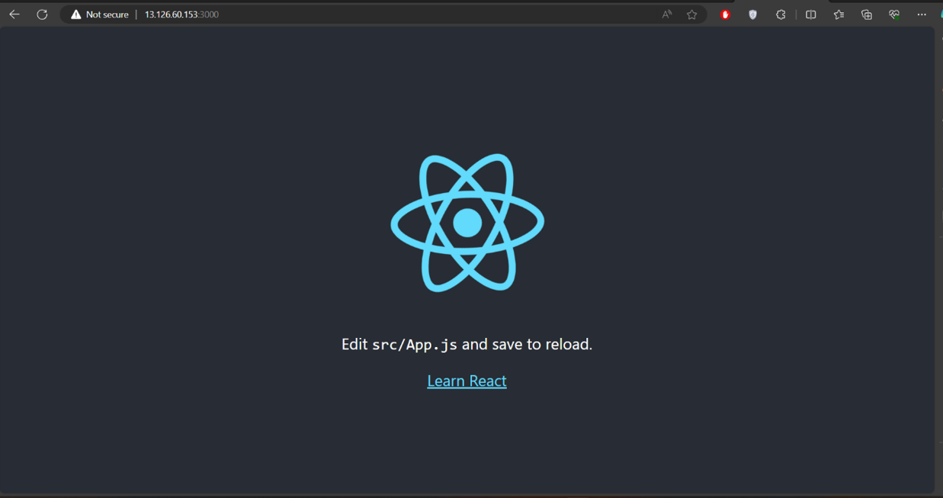
Implementation
Fig 27.Security Group
Fig 28.React site

Slide 34
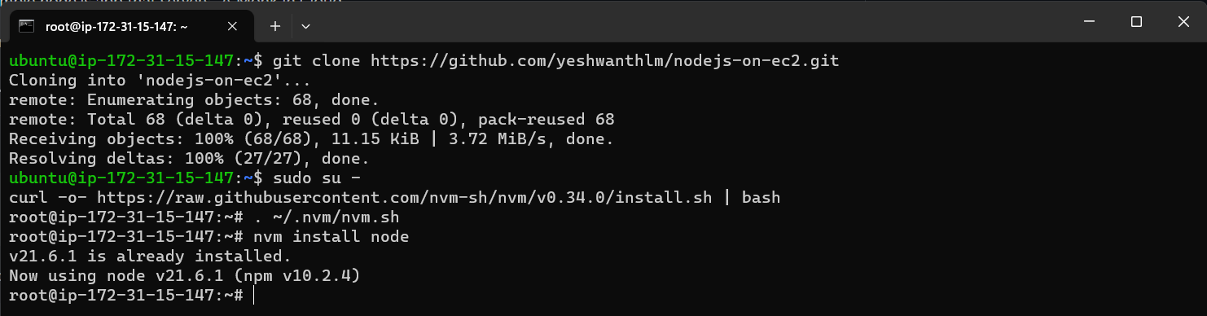
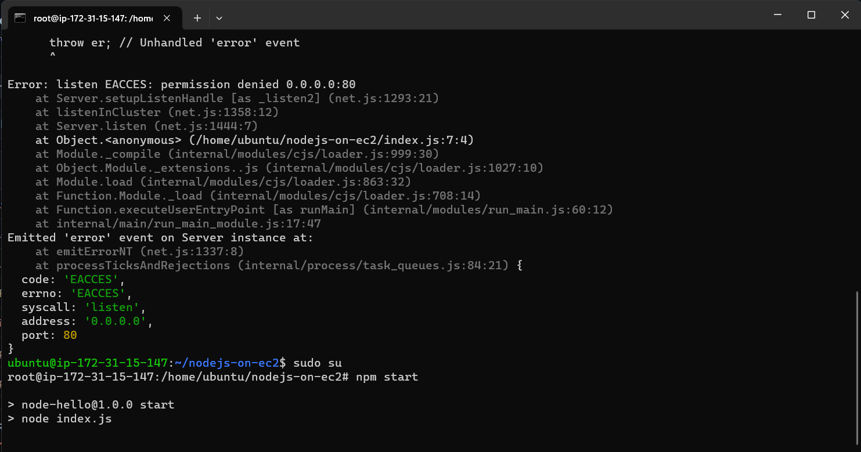
Implementation
Fig 29.Node JS site
Fig 30.Node JS on 80 port

Slide 35
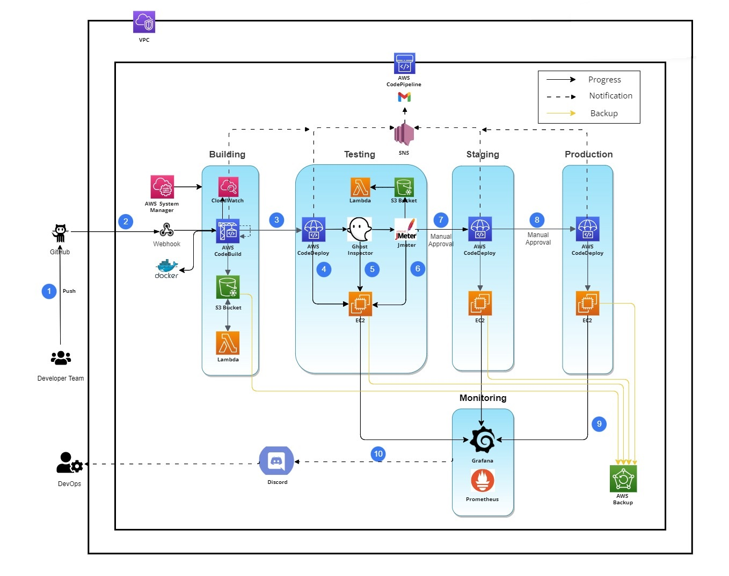
Flowchart
Fig .1 CI/CD Pipeline Flowchart

Slide 36
Components of CI/CD Pipeline
Code pipeline
GitHub
Code build
Code deploy
UI-Testing (Ghost Inspector)
Performance Testing (JMeter)
Lambda function
Load Testing (Grafana)
AWS S3 bucket
Staging deploy (EC2 instance)
Production deploy (EC2 instance)

Slide 37
Pull Request
Firstly , developer will do pull request to main git repository to implement any changes to main branch.
A pull request is a gatekeeper that blocks code commits to the mainline branch and deployments to production.
For code hosting and version control we use GitHub.

Slide 38
GitHub
GitHub is popular among people in the IT industry due to its easy-to-understand UI and its ability to act as a progress tracker using a Version Control System to track changes.
This enables projects to be collaborative.
GitHub is a hosting platform used by developers to save their code online and track its changes to see what will work when it comes to them working on their projects.

Slide 39
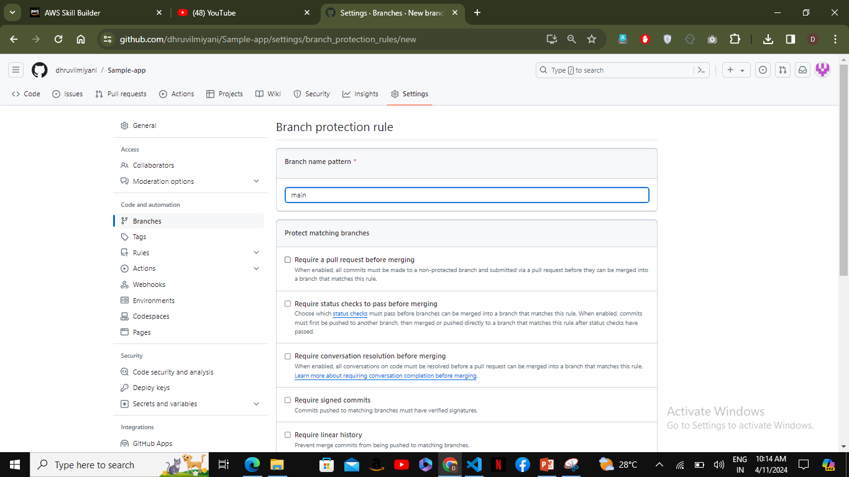
GitHub Screenshot
Fig.2 GitHub Branch Protection Rule

Slide 40
Code Pipeline
AWS Code Pipeline is a continuous delivery service you can use to model, visualize, and automate the steps required to release your software.
You can quickly model and configure the different stages of a software release process.
Code Pipeline automates the steps required to release your software changes continuously.
For security, Code Pipeline uses AWS IAM roles and policies to manage access.
Additionally, all data stored in Code Pipeline is encrypted both in transit and at rest.

Slide 41
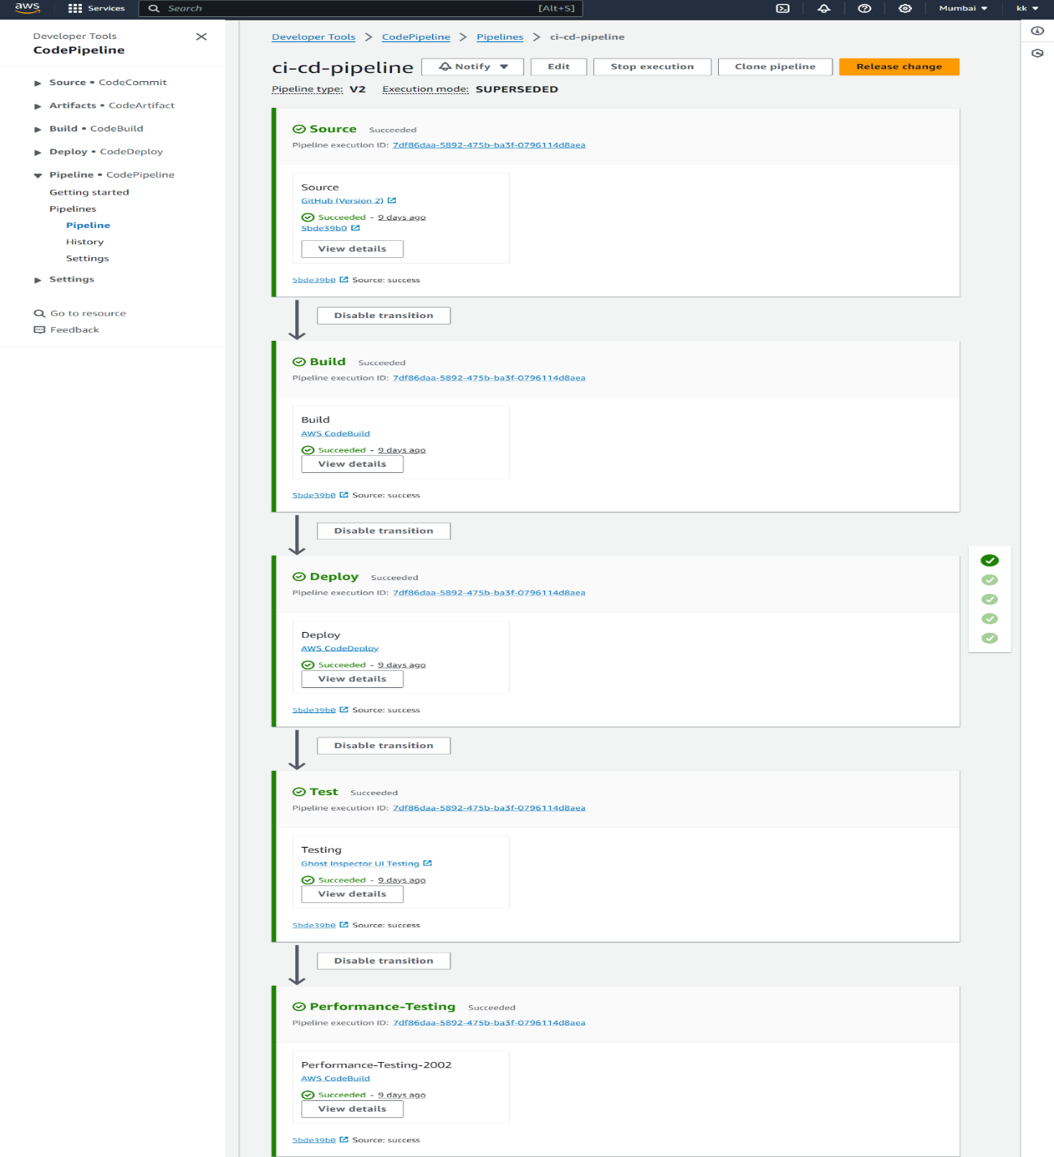
Fig.3 AWS-Pipeline

Slide 42
Code Build
Second stage is Code Build where the building process of code takes place.
AWS Code Build is a fully managed build service in the cloud.
Code Build compiles your source code, runs unit tests, and produces artifacts that are ready to deploy.
Code Build eliminates the need to provision, manage, and scale your own build servers.

Slide 43
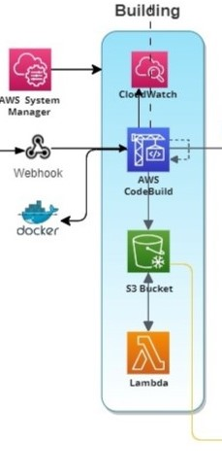
Continue..
As input, you must provide Code Build with a build project.
The build environment can also perform tasks that you specify in the build spec file(for example, sending build notifications to an Amazon SNS topic).
It provides customize build environments in Code Build to use your own build tools.
Code Build scales automatically to meet peak build requests.
Fig.4 Code Build

Slide 44
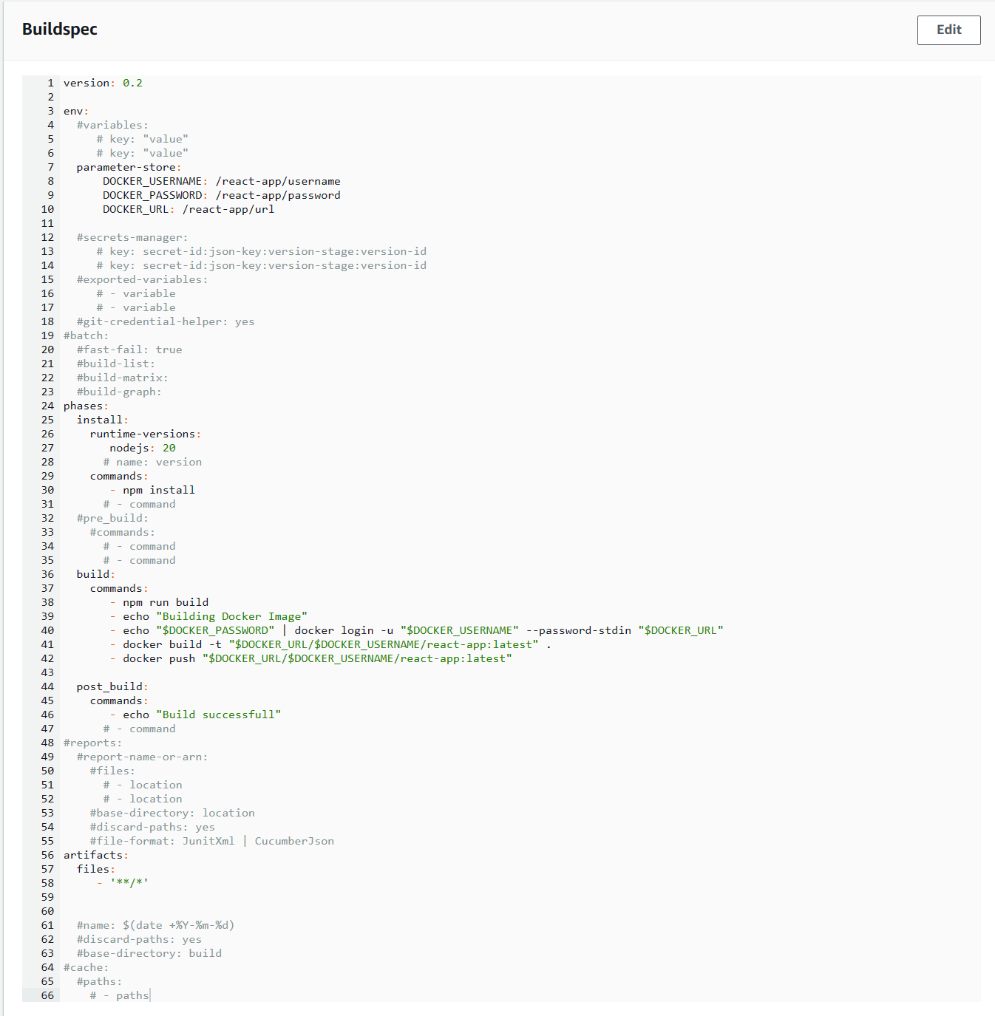
Fig .5 Build spec code

Slide 45
Code Deploy
Code Deploy is a deployment service that automates application deployments to Amazon EC2 instances, on-premises instances, serverless Lambda functions, or Amazon ECS services.
Code Deploy can deploy application content that runs on a server and is stored in Amazon S3 buckets, GitHub repositories, or Bitbucket repositories.
Code Deploy can also deploy a serverless Lambda function.
You do not need to make changes to your existing code before you can use Code Deploy.

Slide 46
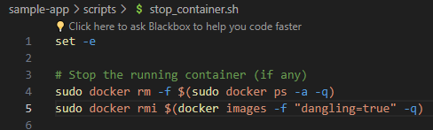
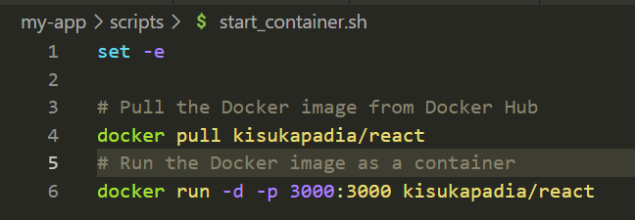
Continue..
A deployment configuration is set of deployment rules and deployment success and failure conditions used by Code Deploy during a deployment.
If your deployment uses the EC2/On-Premises compute platform, you can specify the minimum number of healthy instances for the deployment.
A deployment type is a method used to make the latest application revision available on instances in a deployment group.
Fig .6 Stop container
Fig .7 Start container

Slide 47
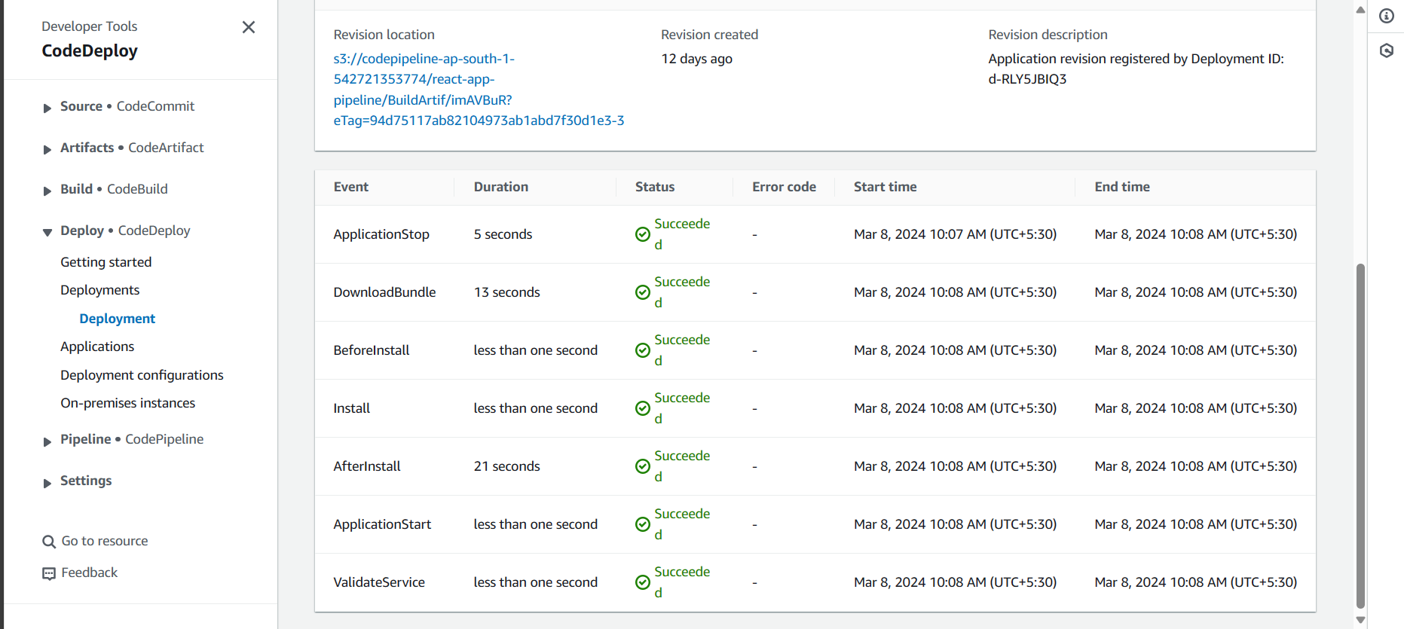
Fig 8.Code Deploy Events

Slide 48
UI Testing
Ghost Inspector is a codeless automated testing product that allows you to easily create and run automated browser tests for your websites and web applications
These tests carry out actions in a web browser the same way a real user would to ensure that everything is working properly.
Building an automated test suite used to mean months of training and coding, all so you could end up with some brittle Selenium scripts that stopped working soon after.
Ghost inspector provides features like Test Recording Extension, Visual Testing via Screenshot Comparison , Parallel Test Running by Default , Data-driven Testing Using Spreadsheets .

Slide 49
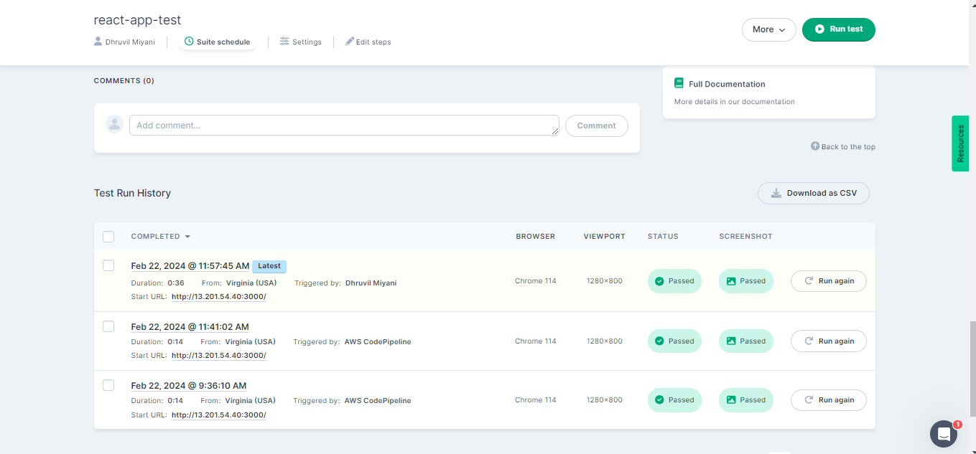
Fig 9.Ghost Inspector

Slide 50
Performance Testing
The Performance Testing is carried out in code build service where all scripts are written in buildspec.yml file.
The JMeter configuration is written in file named react-app.Jmx which is already uploaded to GitHub.
The file is run using JMeter cli command and the result will be stored in .csv file , the dashboard generated for visualization of result will be stored as zip.
Both zip and csv file are uploaded to s3 bucket using AWS cli .
JMeter is totally free, allows developer use the source code for the development.
Test result can be displayed in a different format such as chart, table, tree and log file.

Slide 51
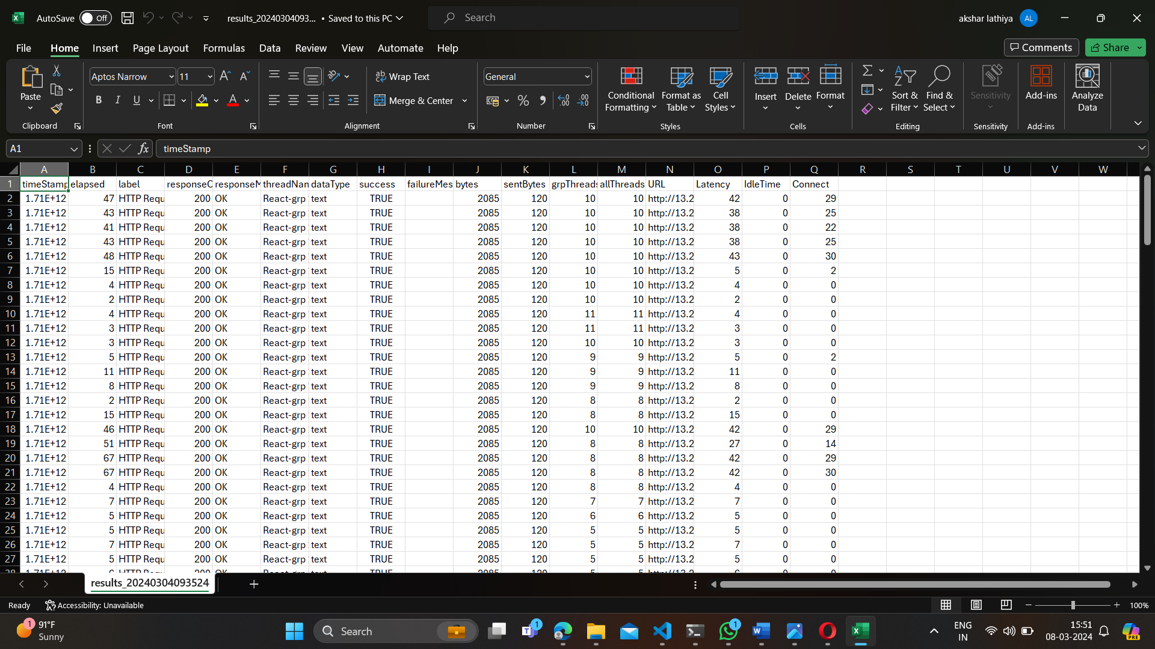
22
Fig .10 Jmeter configuration file

Slide 52
Load Testing
This test is carried out by Grafana.
The Load testing is carried out for ec2 instance , so Grafana is being installed in instance for monitoring.
Grafana is an open-source observability platform for visualizing metrics, logs, and traces collected from your applications.
Grafana is most commonly used as an infrastructure monitoring tool that lets you keep tabs on application performance and error rates.
Grafana is connected with Prometheus to convert metrics data into graphical form.
CPU utilization , memory usage , disk read and write throughput are some graph which are showed in dashboard.

Slide 53
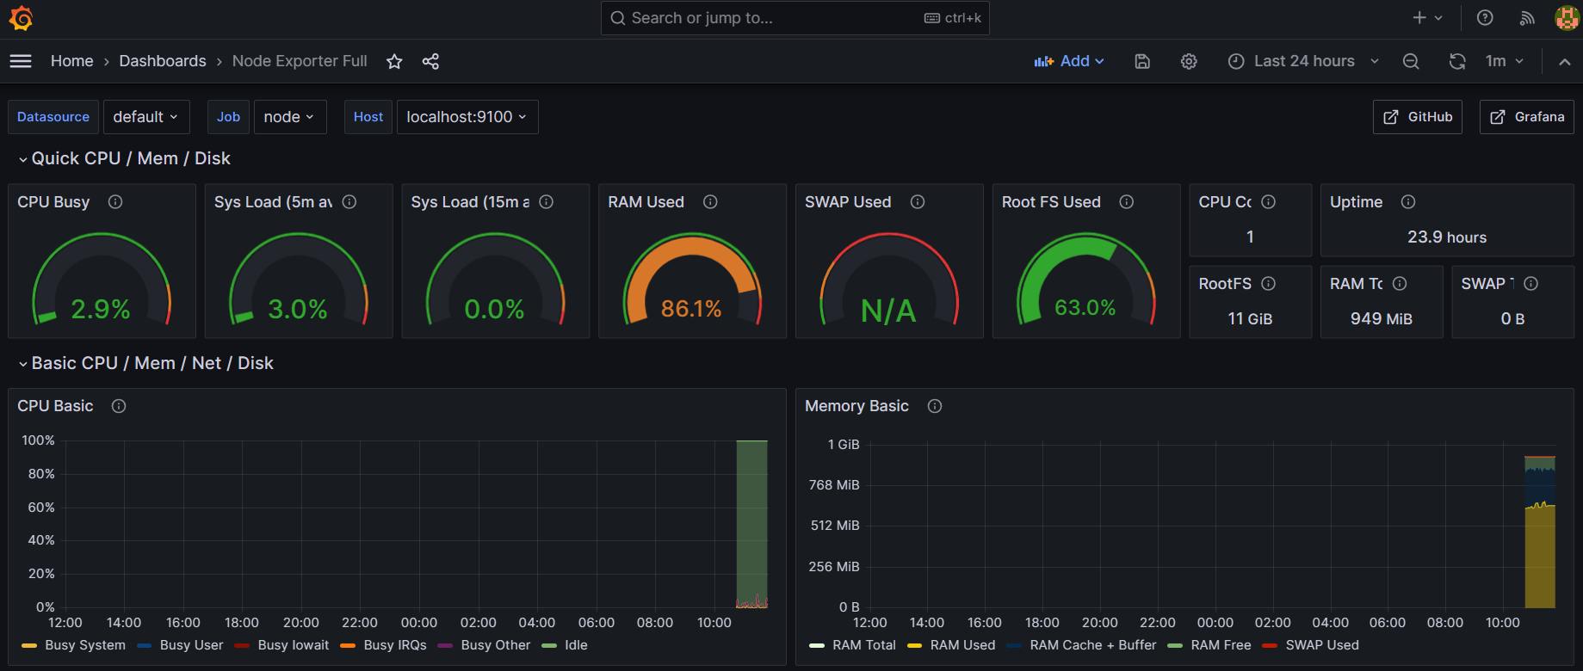
Continue..
The alarm is set for high threshold value of CPU utilization and if it hits the maximum threshold value then it fires alarm , notifies developer through discord which is connected to Grafana by webhook.
Grafana installed will be run on 3000 port of instance and it will required metrics to generate graph.
Prometheus is installed for collecting metrics of instance and it runs on port 9090.
Fig .11Grafana Dashboard

Slide 54
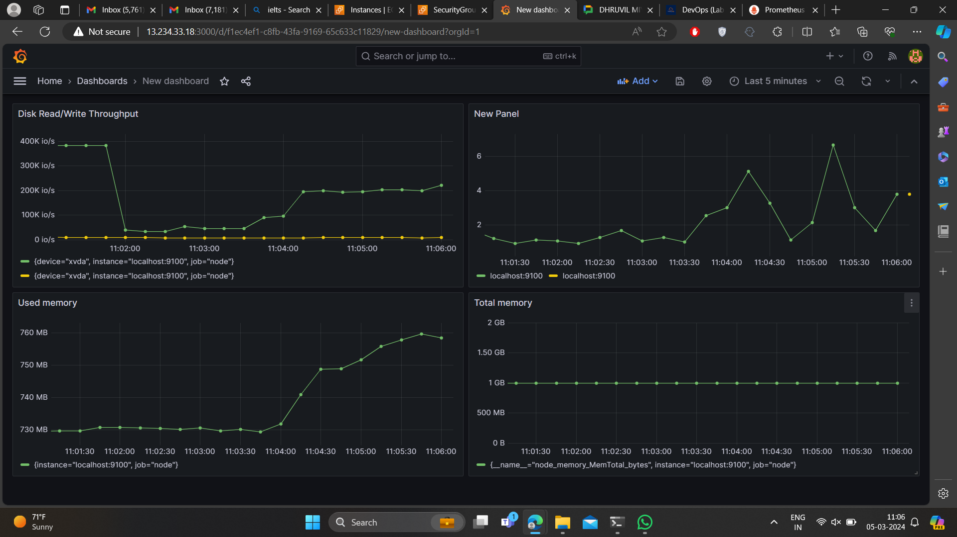
Fig .12 Grafana Dashboard

Slide 55
Simple Notification Service
Amazon Simple Notification Service (Amazon SNS) is a managed service that provides message delivery from publishers to subscribers (also known as producers and consumers).
Clients can subscribe to the SNS topic and receive published messages using a supported endpoint type, such as Amazon Data Firehose, Amazon SQS, AWS Lambda, HTTP, email, mobile push notifications, and mobile text messages (SMS).
Features:- Application-to-application messaging
Application-to-person notifications
Standard and FIFO topics
Message durability
Message security

Slide 56
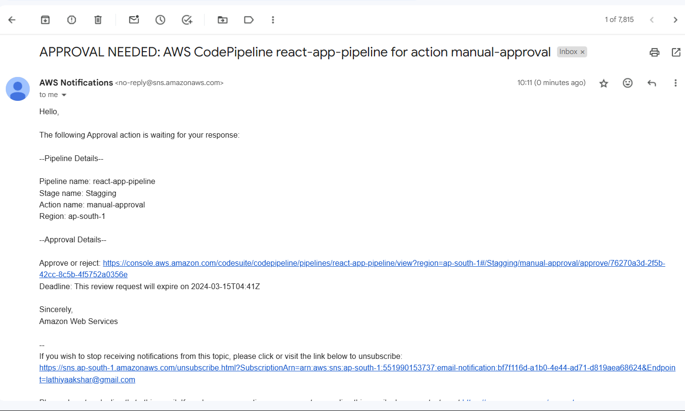
Fig .13 Notification

Slide 57
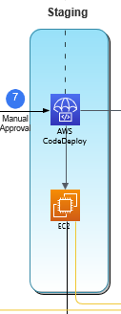
Staging
This stage requires manual approval of developer team head.
A staging environment is a copy of live website and is the last step in the deployment process before changes are deployed to the live website.
The performance of staging instance is monitor using Grafana.
Fig .14 Staging

Slide 58
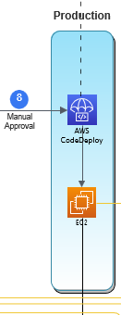
Production
The production stage deploys the code to the live environment.
It might involve deploying to compute services like Amazon EC2 or AWS Lambda.
Valid Code Pipeline action types include source, build, test, deploy, approval, and invoke.
After successful staging , the website is deployed in production environment.
The performance of production instance is also monitor through Grafana.
Fig .15 Production

Slide 59
References
AWS Documentation: AWS Documentation, "AWS Documentation," [Website]. Available: https://docs.aws.amazon.com. [Accessed: Dec. 26, 2023].
AbhishekVeeramalla: AbhishekVeeramalla, "[YouTube]. Available: https://www.youtube.com/@AbhishekVeeramalla. [Accessed: Feb. 12, 2024].
TechnicalGuftgu: TechnicalGuftgu, "[YouTube]. Available: https://www.youtube.com/@TechnicalGuftgu. [Accessed: Dec. 30, 2023].
GouravSharma: GouravSharma, "[YouTube]. Available: https://www.youtube.com/@GouravSharma. [Accessed: Jan. 1, 2024].

Slide 60
Thank You

